Slide 1

CEN5728 - User Experience Design
Video sketch Presentation
Name: Priti Gumaste

Slide 2
Elicitation of Interface Goal
What is the goal of the interface?
What was the problem being solved?
Why this goal & problem?

Slide 3
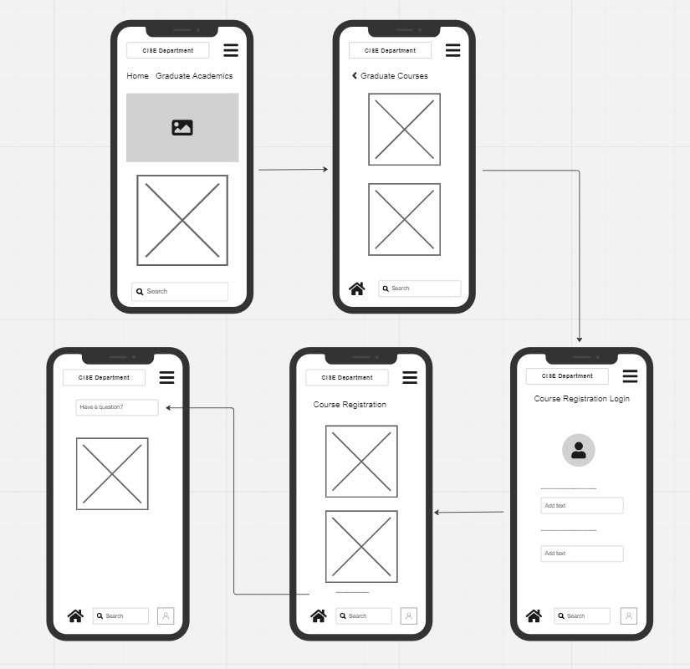
Wire Flow 1

Slide 4
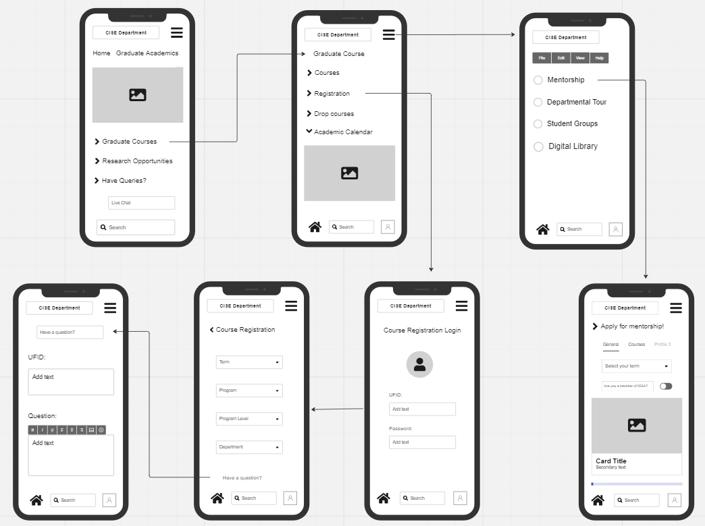
Wire Flow 2

Slide 5
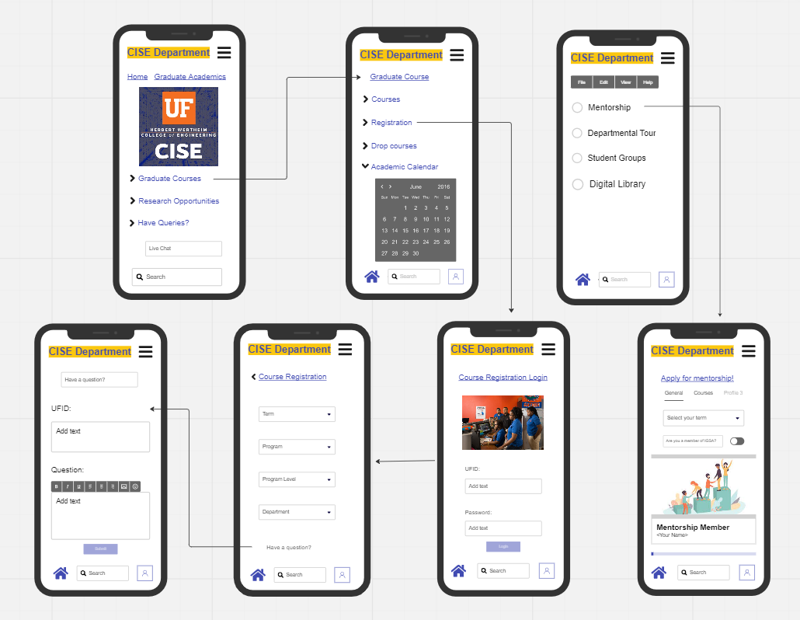
Mock up

Slide 6
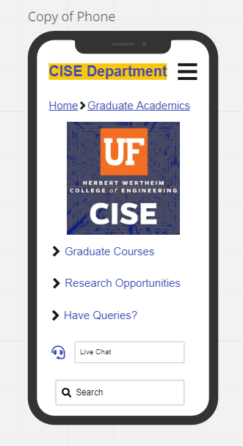
First screen of our wire flow:

Slide 7
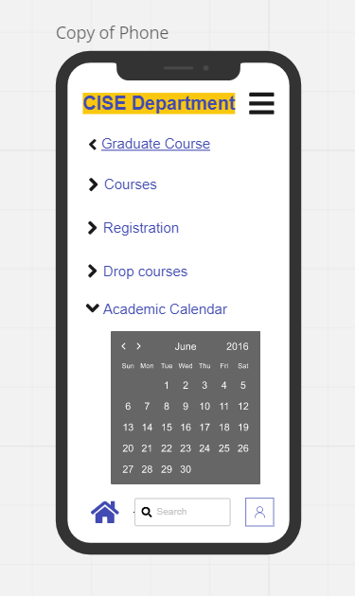

Slide 8
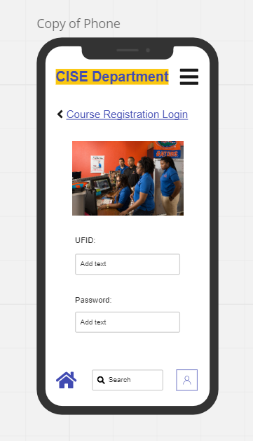

Slide 9
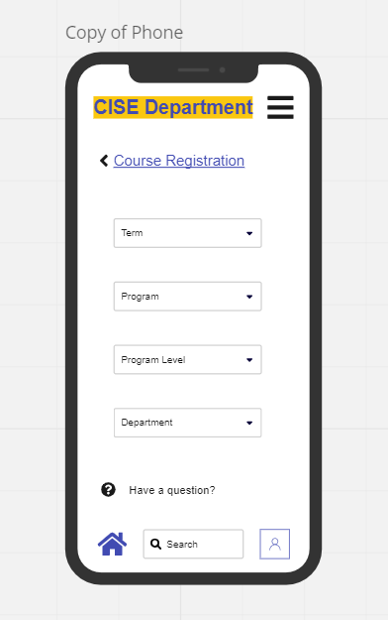

Slide 10
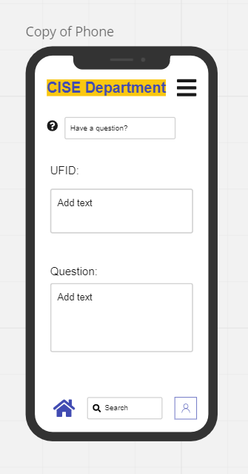

Slide 11
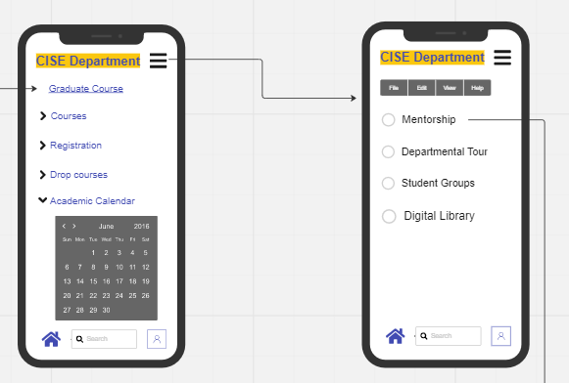

Slide 12
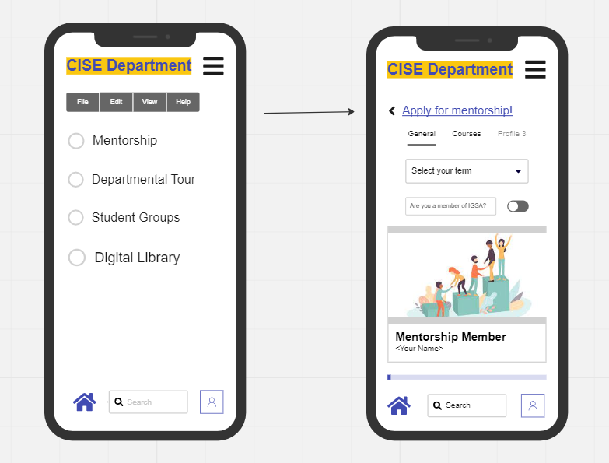

Slide 14
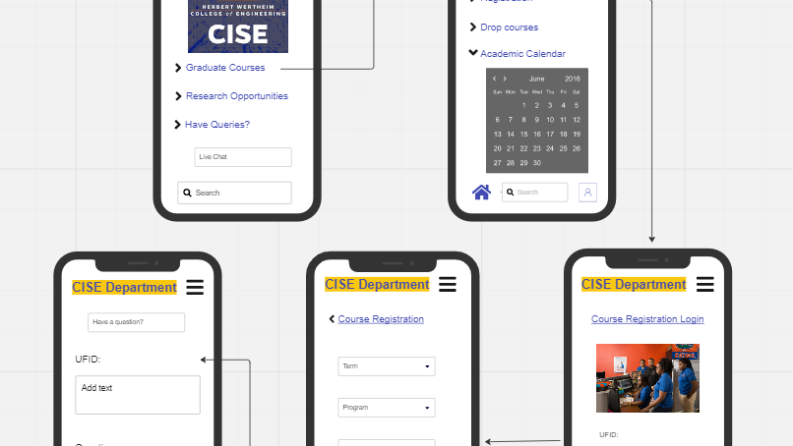
T H A N K Y O U

